Slide 1
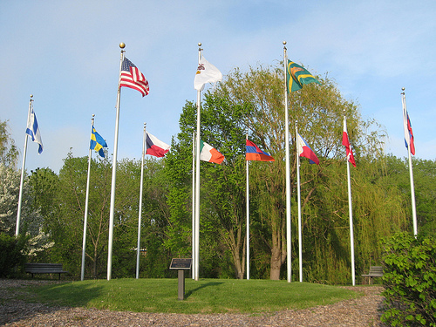
SKOKIE NORTHSHORE SCULPTURE PARK
SECTION 1

Slide 2
Assignment
Choose an image identified by number, spend some time enjoying and thinking about it, finally, interpret it. An interpretation is an educated guess at what the artist is trying to express. What is the action, gesture, motion, meaning? You must back up your opinion by telling why you think that. You will have an opportunity to compare your guess with the artist's actual intention AND you'll get to visit the sculpture in May at the park.
Write a one minute report which you will present to the class

Slide 3
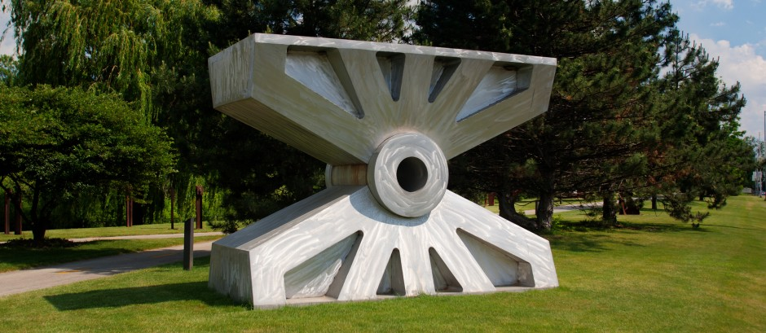
#1

Slide 4
#2

Slide 5
#3

Slide 6
#4

Slide 7
#5

Slide 8
#6

Slide 9
#7

Slide 10
#8

Slide 11
#9

Slide 12
#10

Slide 13
#11

Slide 14
#12

